Slide 1


STATICS FOR COMPUTING
S.A.J.N.N.Samaranayake – COHNDSE23.2F-004
H.D.R.Soysa - COHNDSE23.2F-029
L.K.Siriwardena - COHNDSE23.2F-056
P.K.Hettiarachchi - COHNDSE23.2F-079
A.M.P.A.Bandara - COHNDSE23.2F-080

Slide 2


INTRODUCTION
We were tasked with analyzing and understanding a data set given to us. This data set was collected from 30 individuals from different families in a village before and after a welfare program was conducted by a non-government organization

Slide 3

IDENTIFYING VARIABLES
X1 : Age – Continuous
X2 : Income before the program - Continuous
X3 : Income after the program - Continuous
X4 : Level of education - Categorical
X5 : Marital status - Categorical
X6 : Gender - Categorical
X7 : Number of members in household - Discrete
X8 : Program status - Categorical

Slide 4
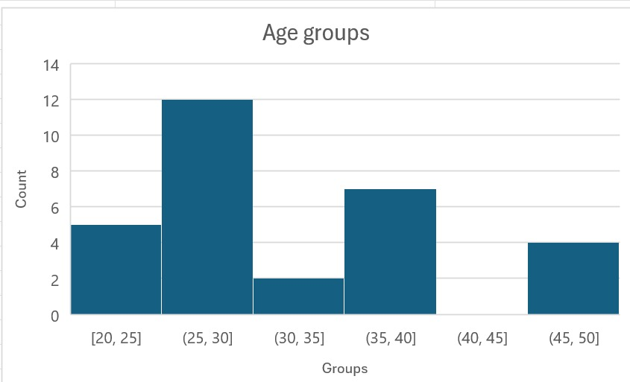
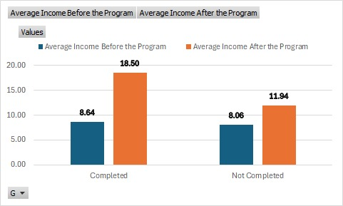
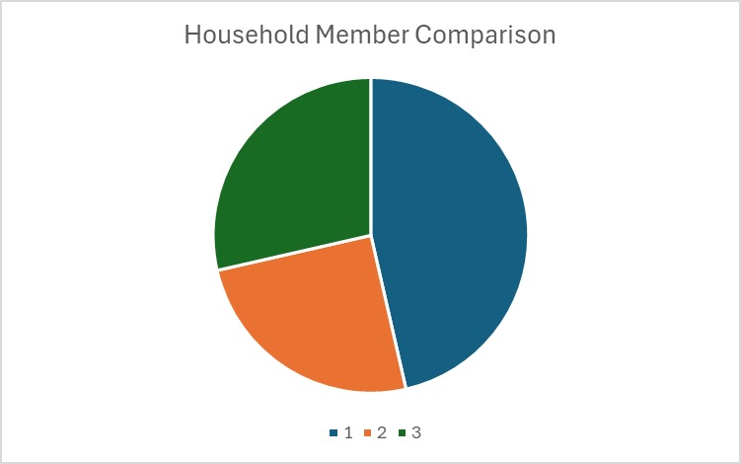
QUANTITATIVE DATA – GRAPHICAL REPRESENTATION
The income of the participants have increased in comparison to the participants who didn’t complete the program
There is a declare in participation as age increases since the highest participation is in the 25 – 30 range
The most common household size is 3.

Slide 5
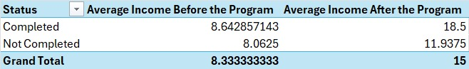
QUANTITATIVE DATA – NUMERICAL REPRESENTATION
Age (in years) |  | Income before the program (in thousand) |  | Income after the program (in thousand |  | Number of members in household
X1 |  | X2 |  | X3 |  | X7
Mean | 32 | Mean | 8.333333333 | Mean | 15 | Mean | 2.033333333
Standard Error | 1.501723148 | Standard Error | 0.285001848 | Standard Error | 0.904649548 | Standard Error | 0.211634761
Median | 29 | Median | 8 | Median | 14 | Median | 2
Mode | 29 | Mode | 8 | Mode | 12 | Mode | 1
Standard Deviation | 8.225276434 | Standard Deviation | 1.561019413 | Standard Deviation | 4.95496964 | Standard Deviation | 1.159171325
Sample Variance | 67.65517241 | Sample Variance | 2.436781609 | Sample Variance | 24.55172414 | Sample Variance | 1.343678161
Kurtosis | -0.567570179 | Kurtosis | -0.073373849 | Kurtosis | -0.503003682 | Kurtosis | 0.814861957
Skewness | 0.477223461 | Skewness | 0.623771664 | Skewness | 0.51567956 | Skewness | 1.069843563
Range | 28 | Range | 6 | Range | 18 | Range | 4
Minimum | 20 | Minimum | 6 | Minimum | 8 | Minimum | 1
Maximum | 48 | Maximum | 12 | Maximum | 26 | Maximum | 5
Sum | 960 | Sum | 250 | Sum | 450 | Sum | 61
Count | 30 | Count | 30 | Count | 30 | Count | 30

Slide 6
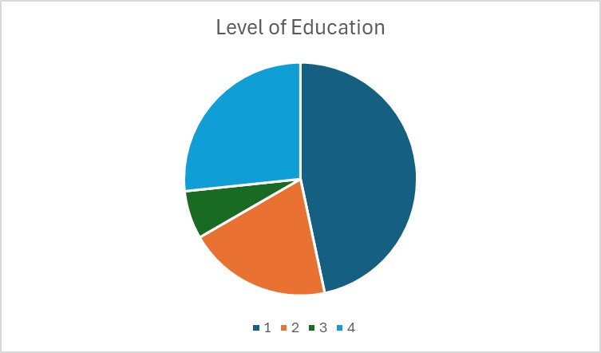
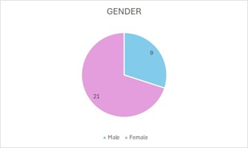
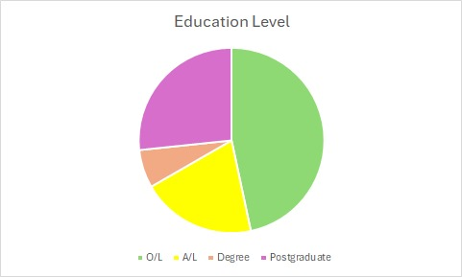
QUALITATIVE DATA
The amount of married and unmarried individuals who participated in the program are equal
Most people who participated in the program has passed O / levels
More females have participated in the program than males

Slide 7
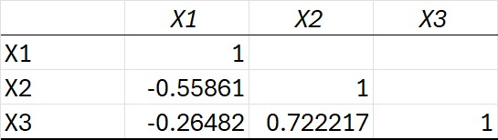
CORELATION REPRESNTATION
The weak negative correlation between age and income after the program in comparison to before to program shows that age has a less of an impact ion income after the program.
Strong positive correlation between income before and after the program highlights the effectiveness of the program on high income individuals .

Slide 8
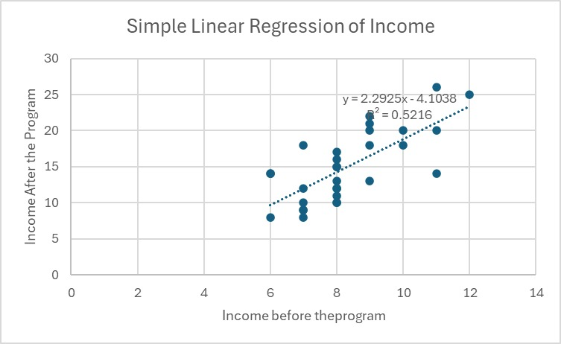
LINERA REGRESSION
The upper slop of the linear regression line indicates that there is positive linear relationship before and after the program.
The program seems to benefits the participants specially those with higher starting incomes.

Slide 9

CONCLUSION
In conclusion the welfare program seems to have been effective on the test group of individuals because the income of the individuals after the program seems to have increased considerably in comparison to the income before the program was conducted.

Slide 10

THANK YOU

